Slide 1
Java Crash Course

Slide 2
Java Crash Course
Introduction to Java Programming: Your Journey Begins!
Java's Magic: Platform Independence
The Java Ecosystem: JVM, JDK, JRE Explained
Your First Steps: Java Syntax Fundamentals
Storing Information: Variables & Data Types
Directing the Flow: Control Structures
Building Blocks: Methods in Java
Thinking in Objects: Introduction to OOP
Mastering OOP: Core Concepts in Java
Your First Project: Bank Account System

Slide 3
Java Crash Course
Beyond the Basics: Expanding Your Project
Next Steps: Recap & Resources

Slide 4
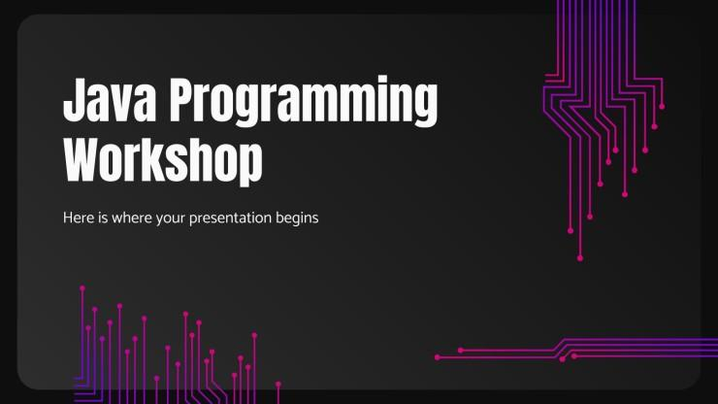
Introduction to Java Programming: Your Journey Begins!
Brief Welcome: Get ready to explore the exciting world of Java!
Agenda Overview: We'll cover Java fundamentals, OOP, and a hands-on project.
Learning Goals: Understand core concepts, write basic Java programs, and apply OOP principles.

Slide 5
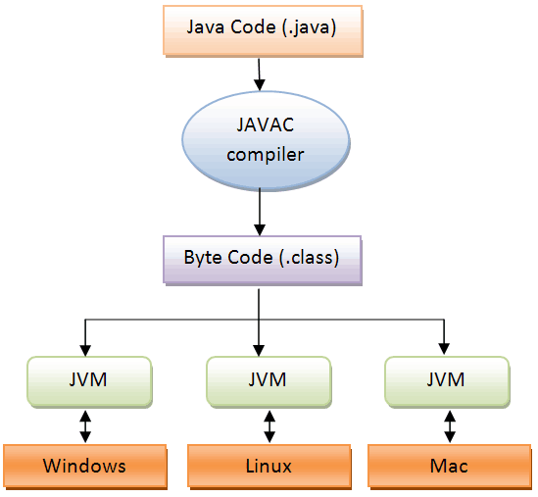
Java's Magic: Platform Independence
Platform Independence: Write Once, Run Anywhere (WORA).
Compilation Process: Java Source Code (.java) -> Java Compiler (javac) -> Bytecode (.class).
Execution Process: Bytecode -> Java Virtual Machine (JVM) -> Native Machine Code.

Slide 6
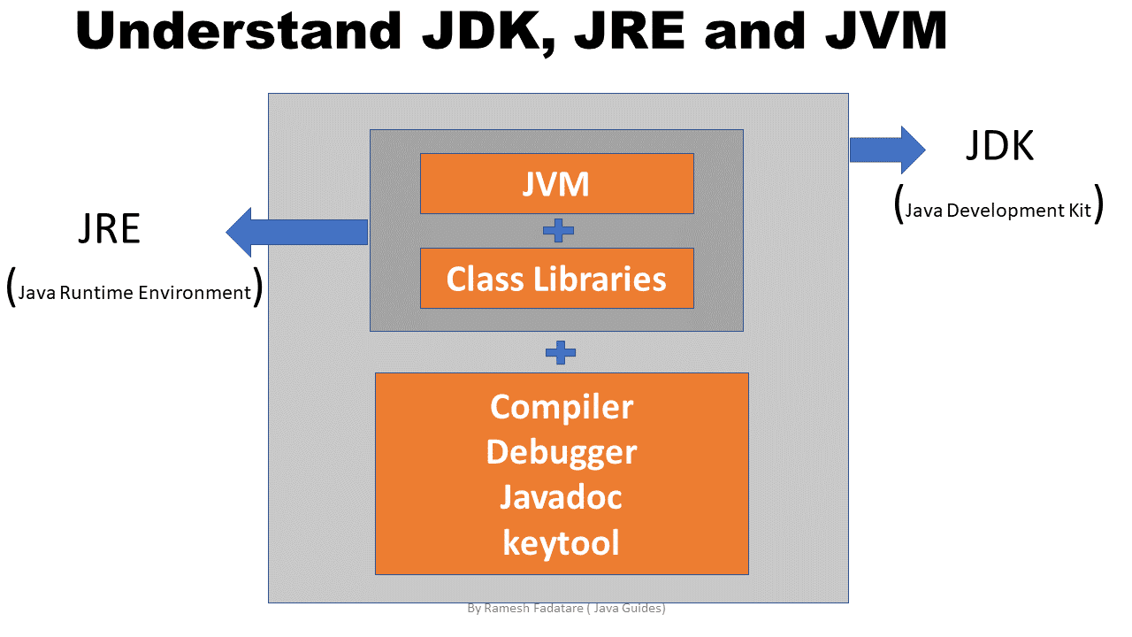
The Java Ecosystem: JVM, JDK, JRE Explained
JVM (Java Virtual Machine): The runtime engine that executes Java bytecode.
JRE (Java Runtime Environment): Provides the runtime environment for Java applications (JVM + libraries).
JDK (Java Development Kit): A complete set for Java development (JRE + development tools like compiler, debugger).

Slide 7
Your First Steps: Java Syntax Fundamentals
Structure of a Basic Java Program: Class definition, `main` method, statements.
Syntax Rules: Case-sensitive, statements end with a semicolon (`;`).
Comments: `//` for single-line, `/* ... */` for multi-line.

Slide 8
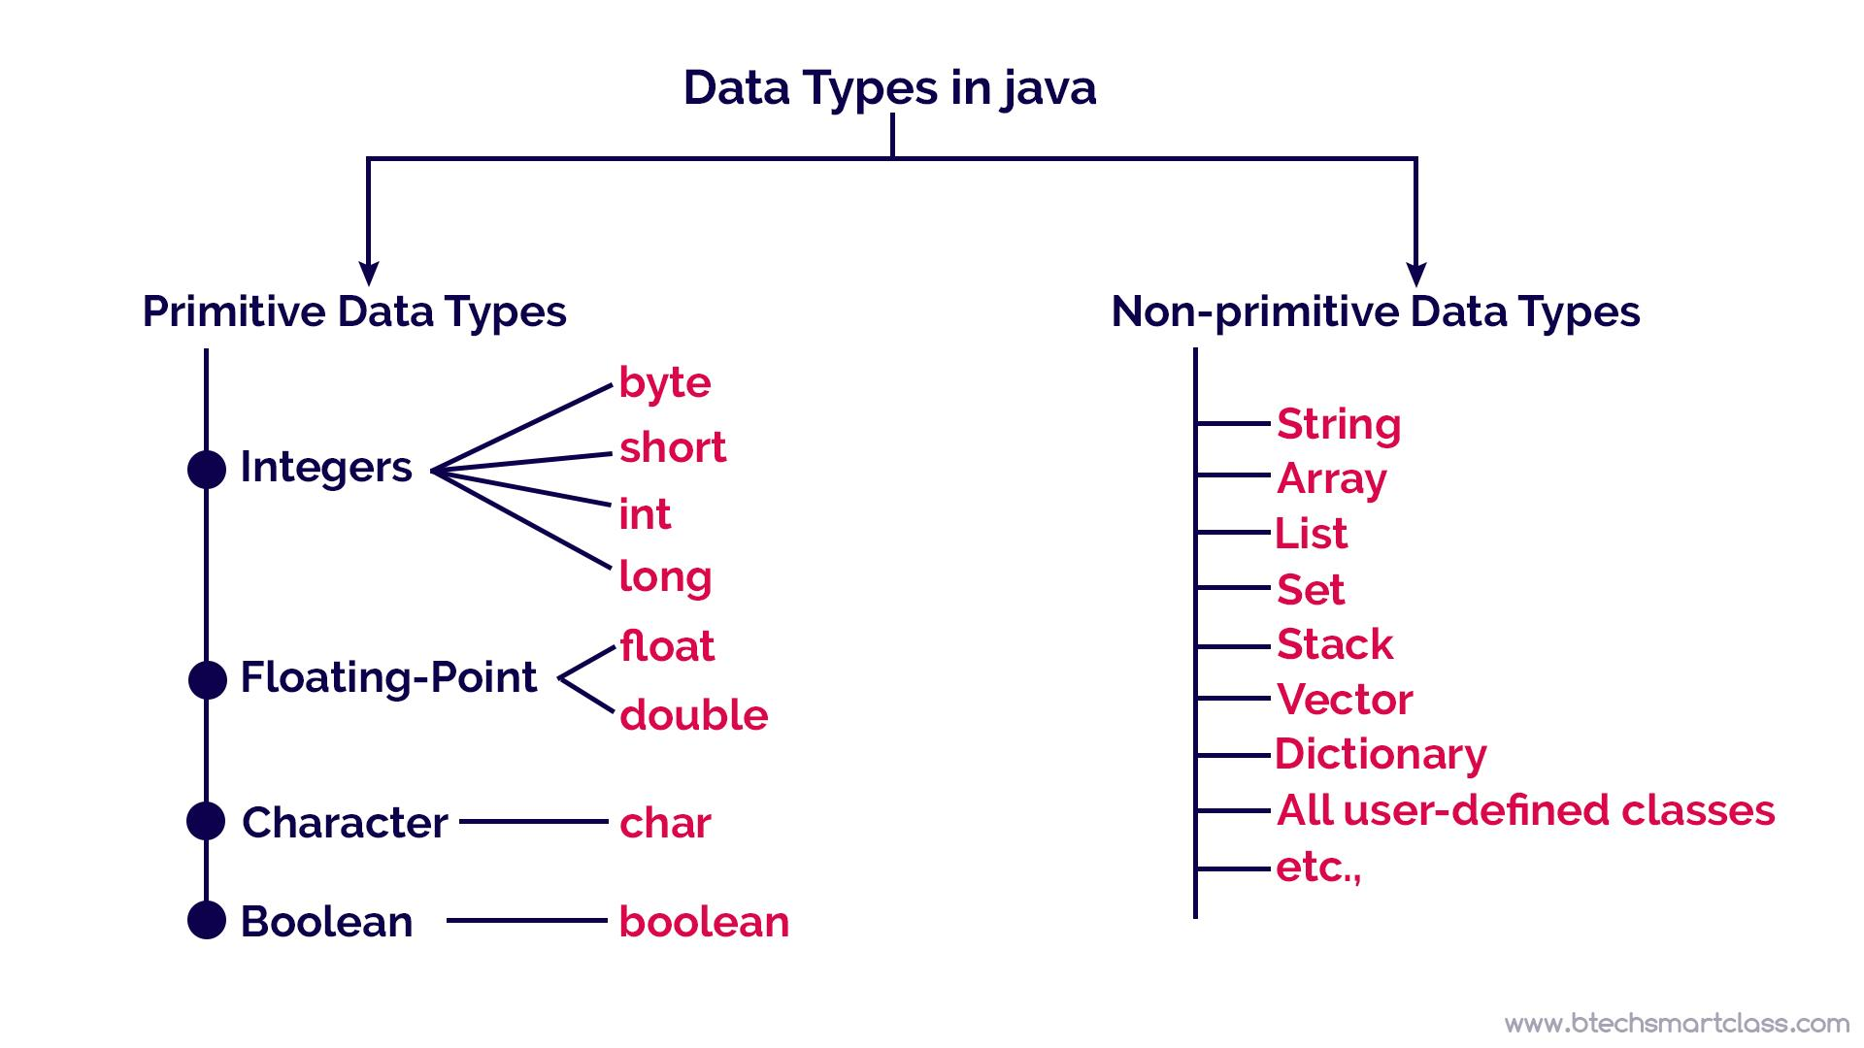
Storing Information: Variables & Data Types
Primitive Types: `byte`, `short`, `int`, `long`, `float`, `double`, `boolean`, `char` (basic values).
Non-Primitive (Reference) Types: `String`, Arrays, Classes, Interfaces (objects, refer to memory locations).
Variable Declaration & Initialization: `int age = 30;`.

Slide 9
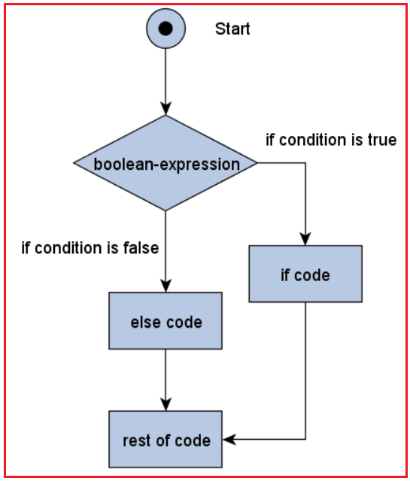
Directing the Flow: Control Structures
Conditional Statements:
- `if`/`else if`/`else`: Execute code based on conditions.
- `switch`: Execute code based on matching discrete values.

Slide 10
Building Blocks: Methods in Java
Method Declaration: Defines the method's signature (access modifier, return type, name, parameters).
Method Usage: Calling a method to perform an action.
Return Types & Parameters: Methods can return values and accept inputs.

Slide 11
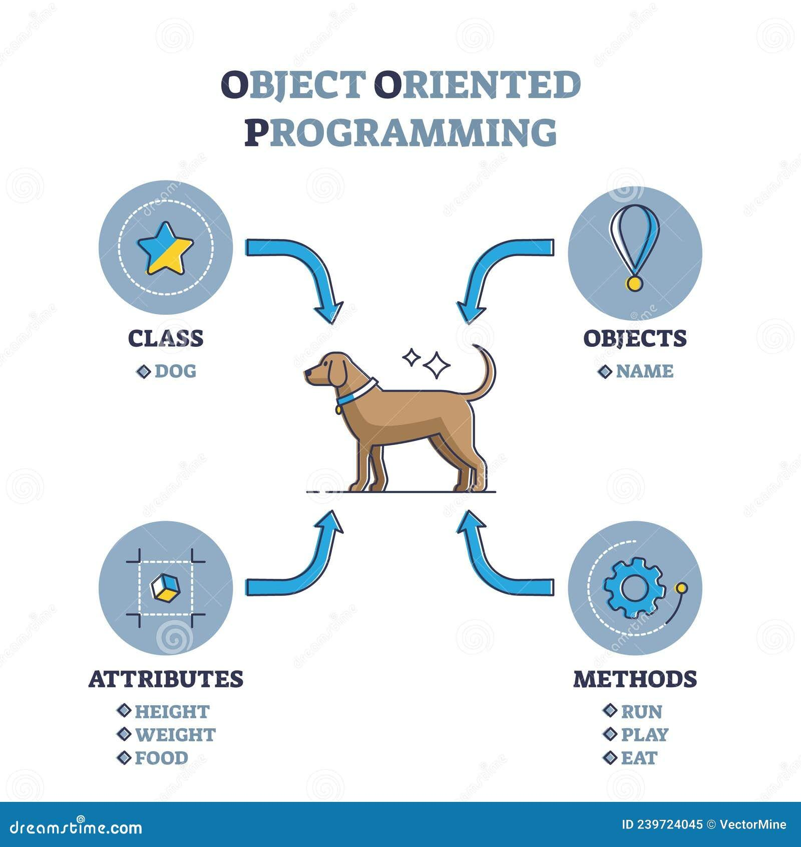
Thinking in Objects: Introduction to OOP
What is OOP?: A programming paradigm based on the concept of 'objects'.
Why it Matters?: Modularity, reusability, maintainability, scalability, and real-world modeling.
Real-world Analogy: Imagine a 'Car' blueprint (Class) used to create individual 'Car' instances (Objects) with their own color, model, and behavior (start, stop).
Generated on AIDOCMAKER.COM (Image Credit)

Slide 12
Mastering OOP: Core Concepts in Java
Classes and Objects: Blueprint for objects (Class), instance of a class (Object).
Inheritance: A class (subclass) can inherit properties and methods from another class (superclass).
Polymorphism: Objects can take on many forms (method overriding, method overloading).

Slide 13

Your First Project: Bank Account System
Console-based Bank Account Management System.
Features:
- Account Creation: Create new bank accounts.

Slide 14

Beyond the Basics: Expanding Your Project
Assignment Brief: Extend the Bank Account app.
Transaction Handling: Implement a transaction history feature.
Input Validation: Ensure robust user input (e.g., positive amounts, valid account numbers).

